Slide 1
Vision Transformers for Physics Prediction
Anthony Kalaydjian

Slide 2
Agenda
01
03
Problem statement
Experiments
02
04
Method
Results

Slide 3
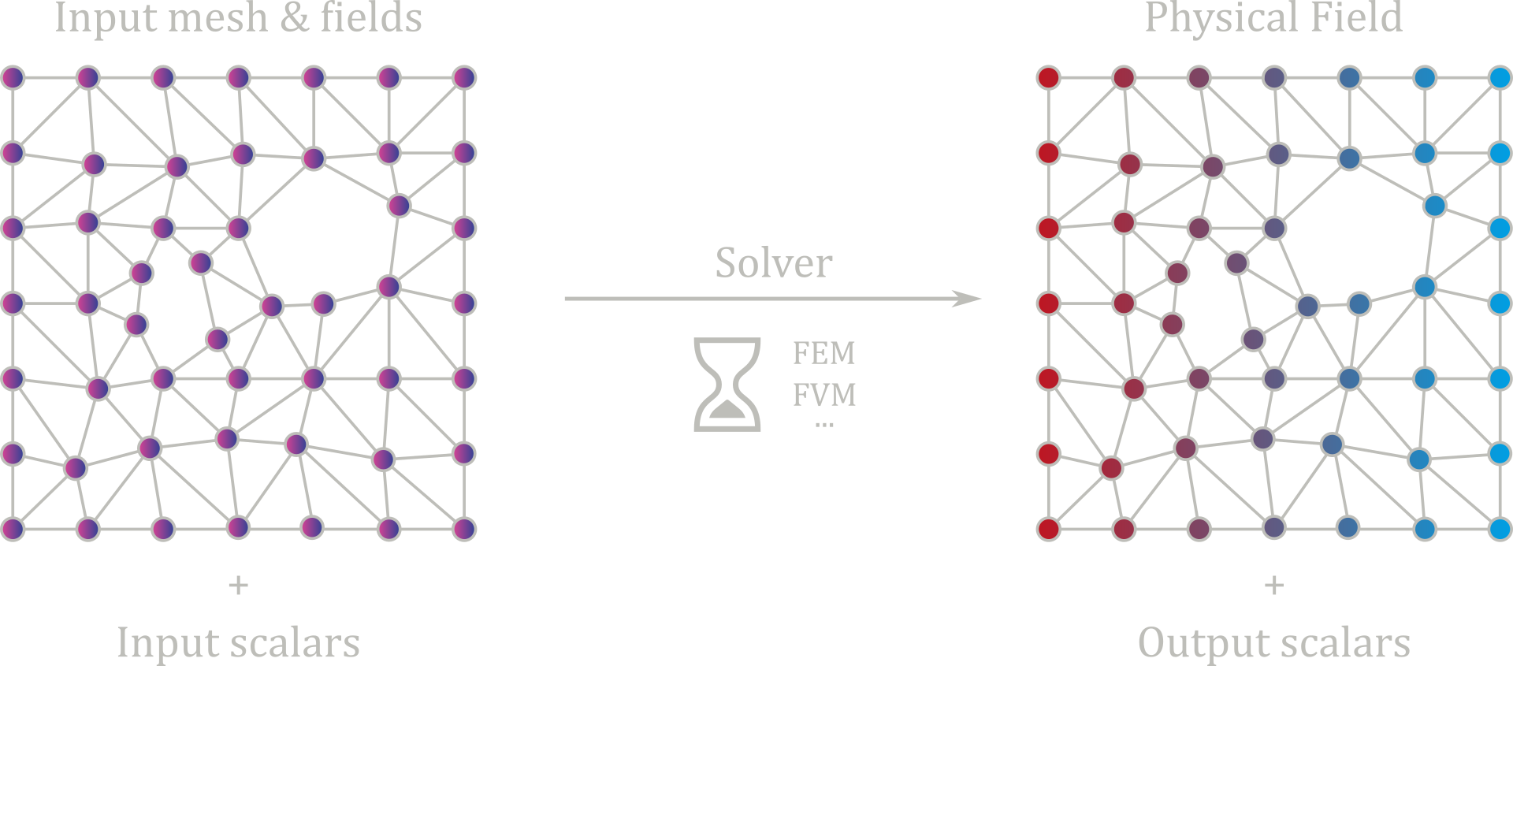
Problem statement

Slide 4
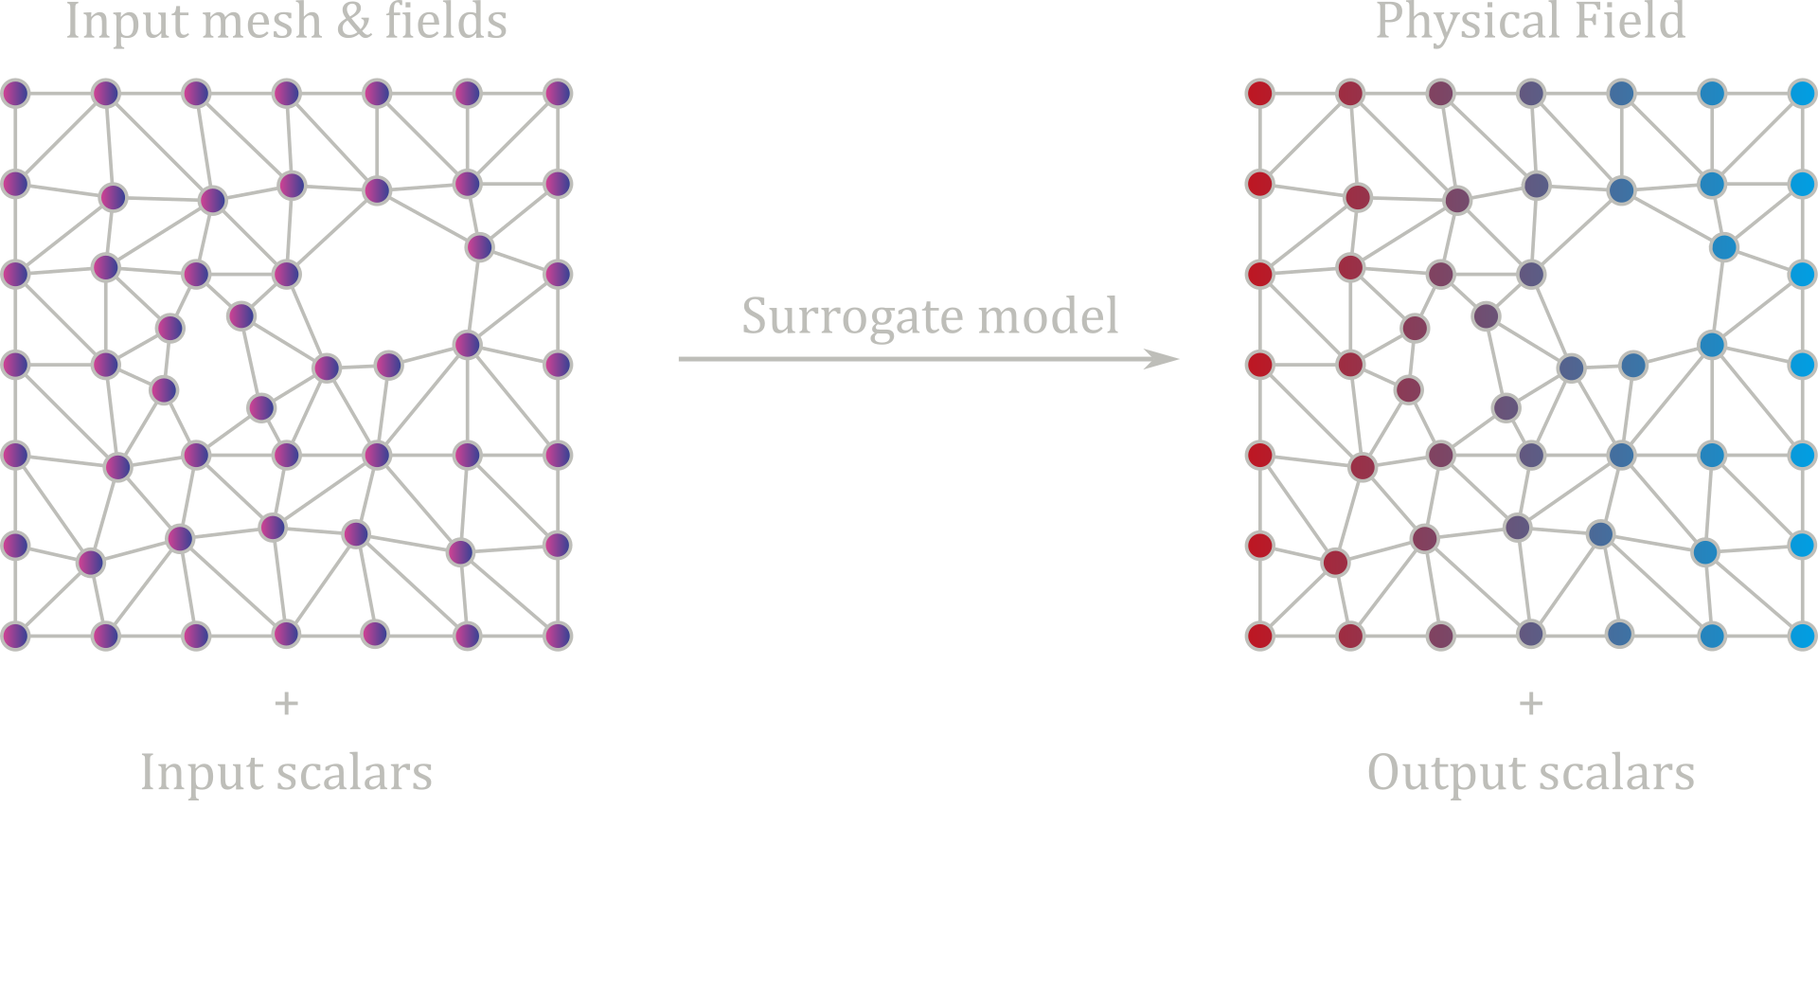
Problem statement

Slide 5
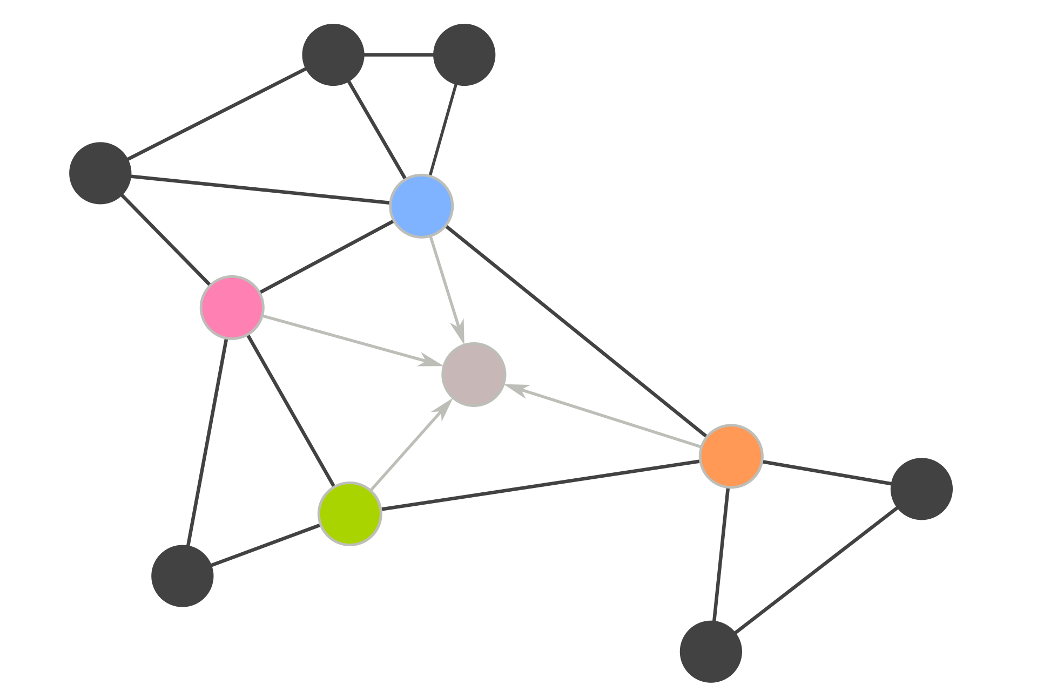
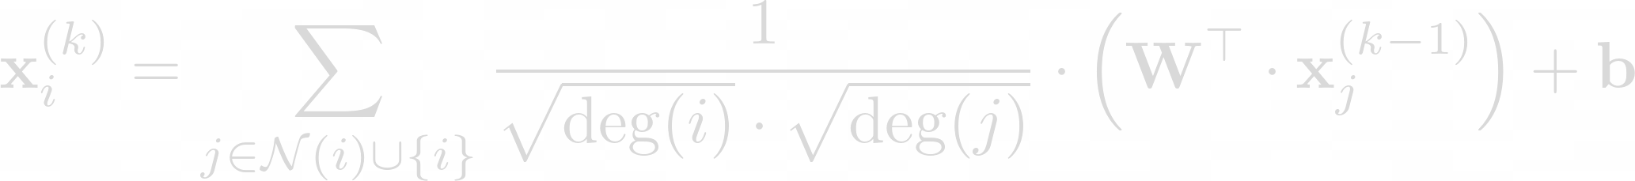
Problem statement

Slide 6
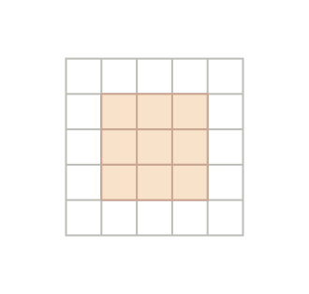
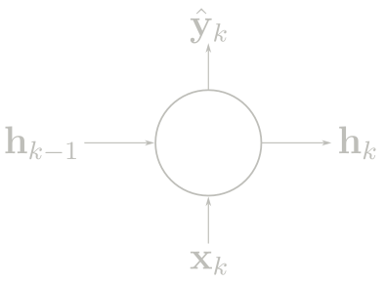
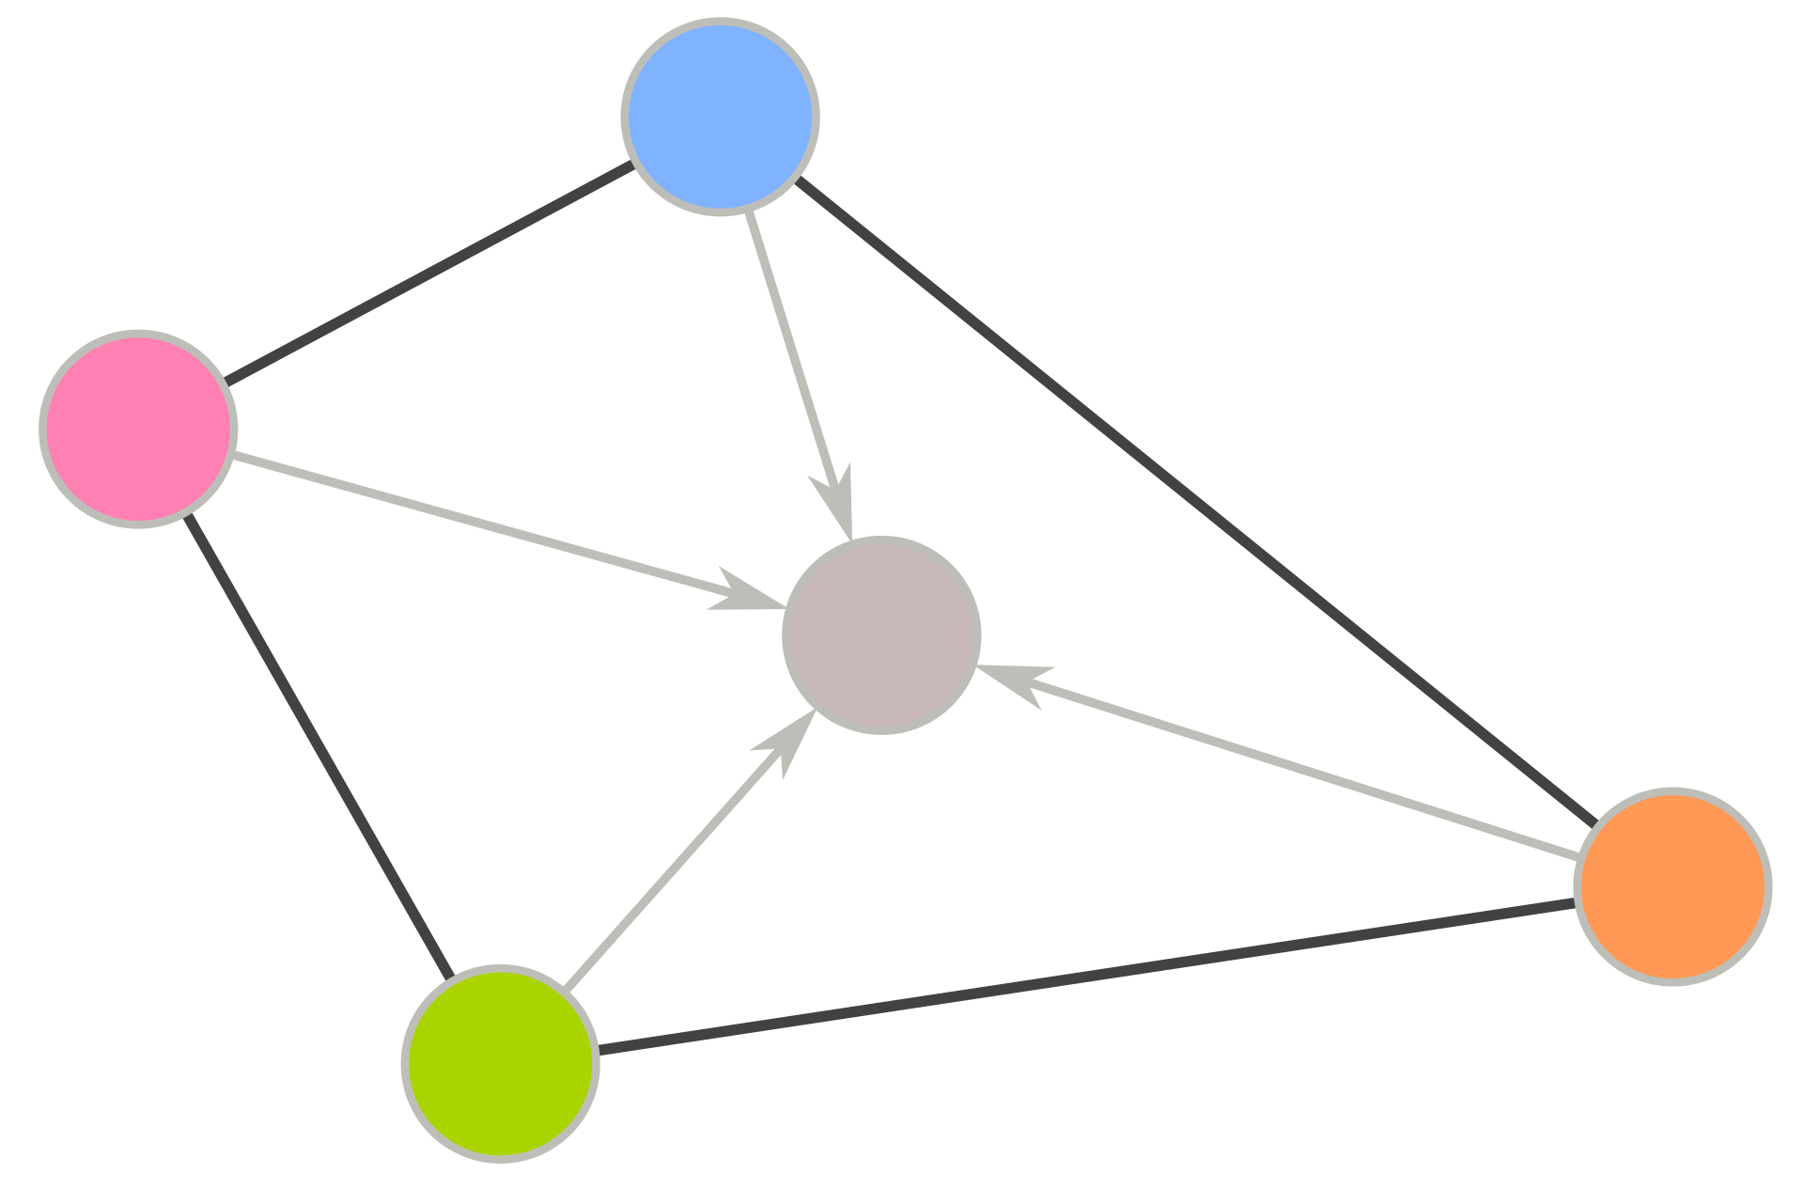
Problem statement
RNN
CNN
GNN

Slide 7
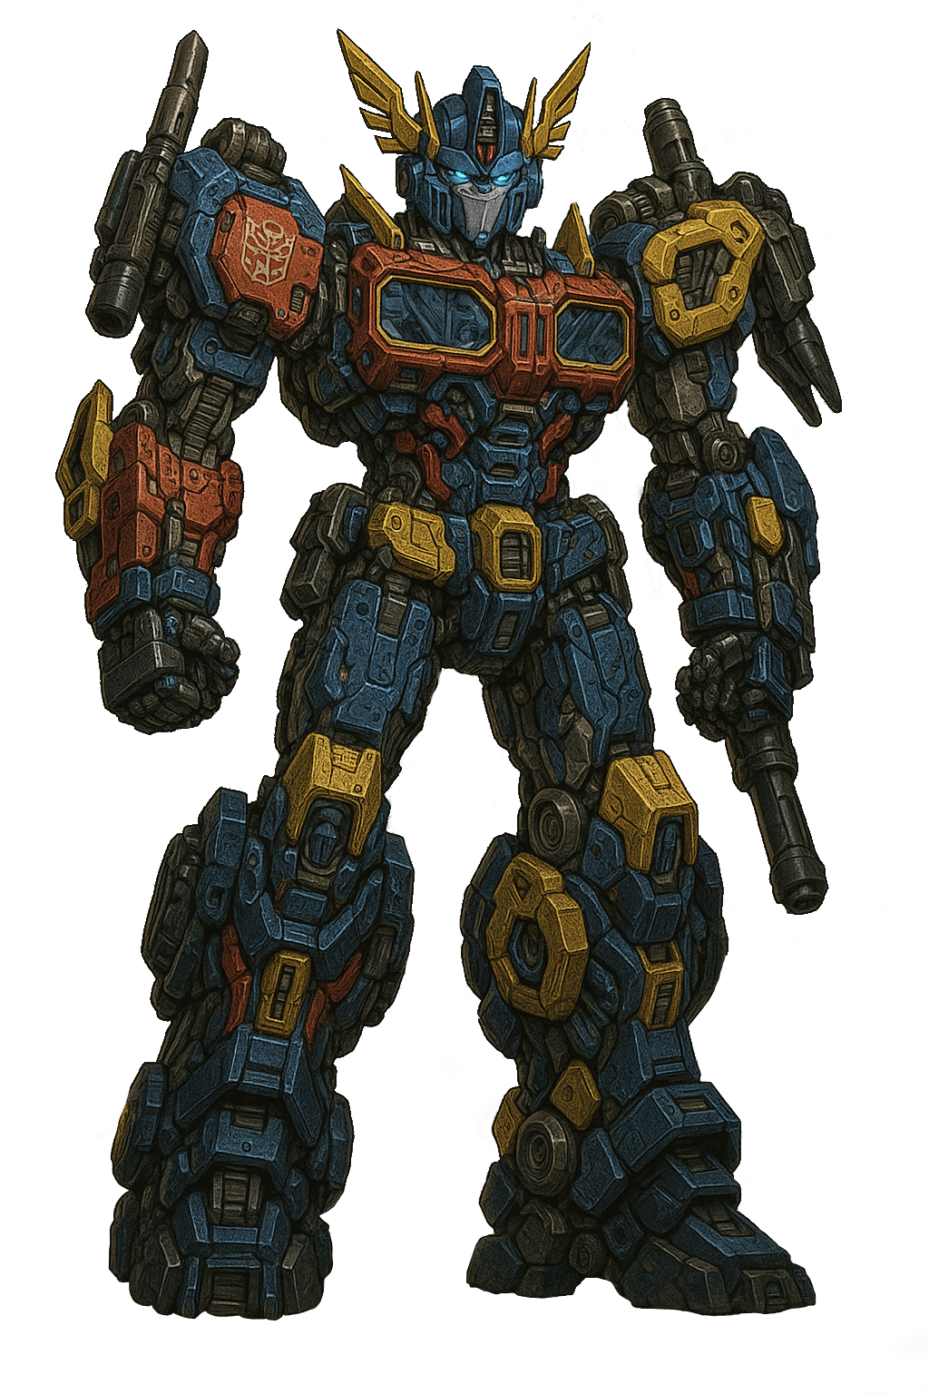
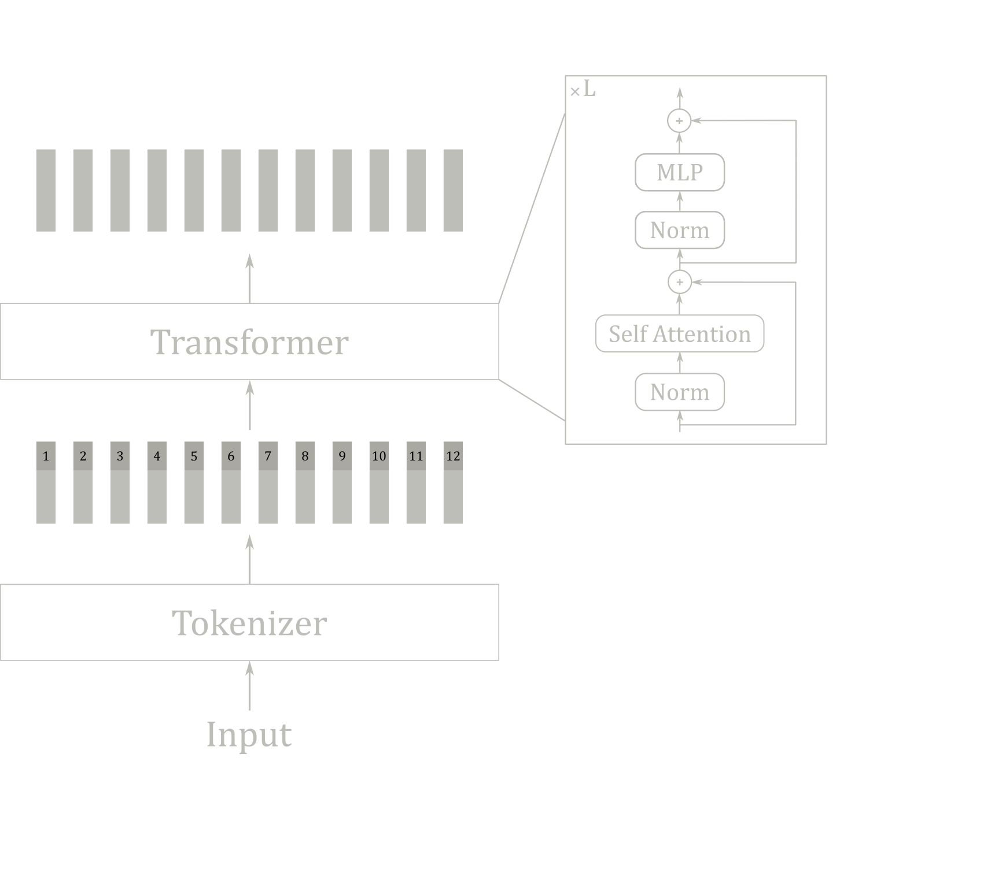
Method
Transformer generated by a transformer

Slide 8








Method
Attention
Self-Attention

Slide 9
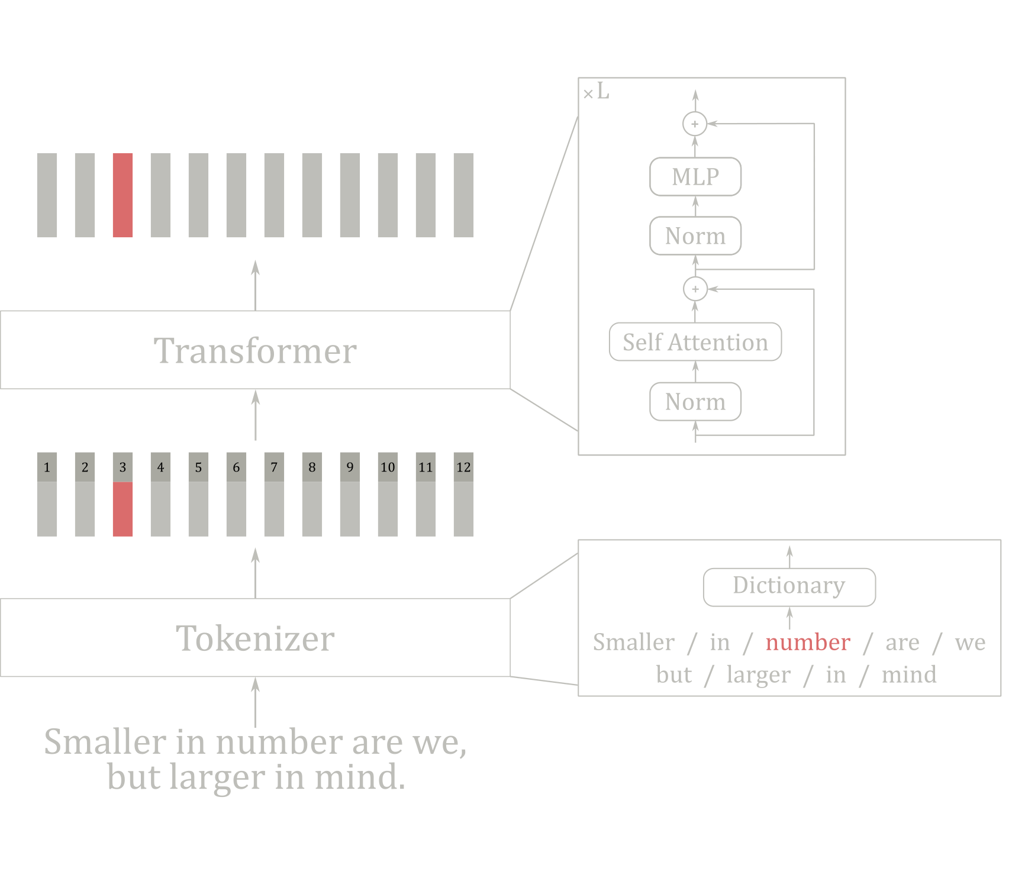
Method

Slide 10
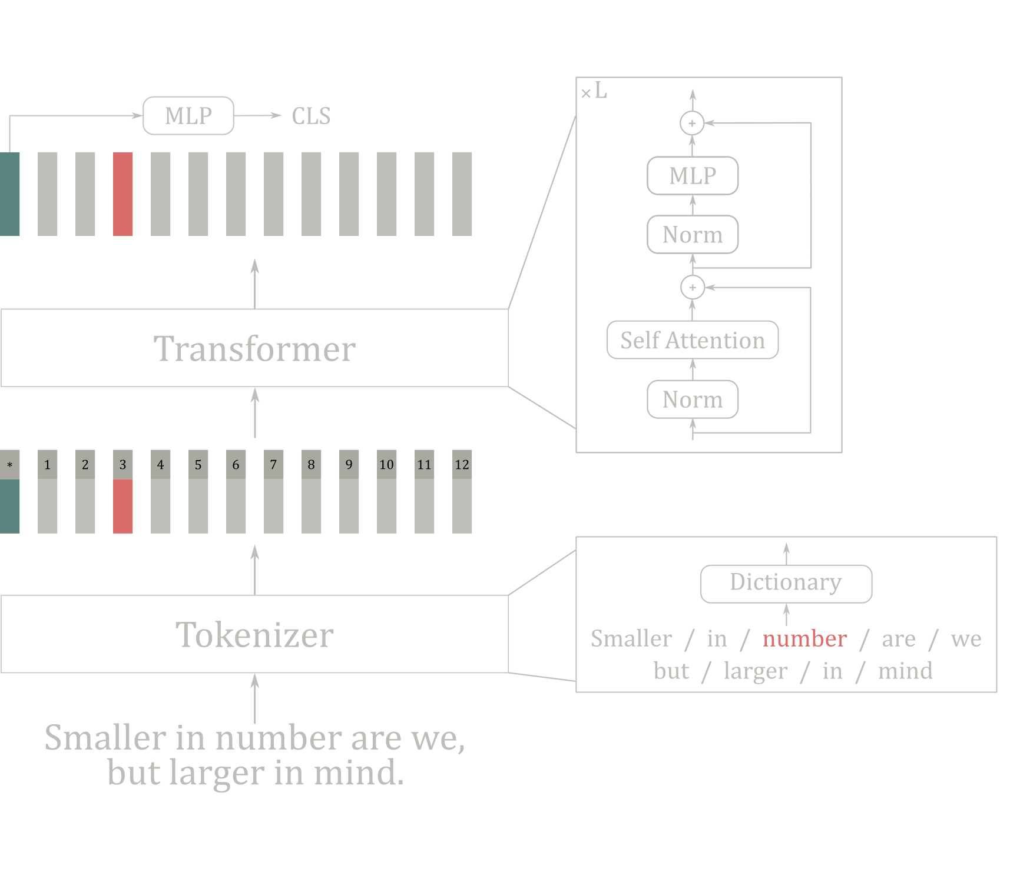
Method

Slide 11
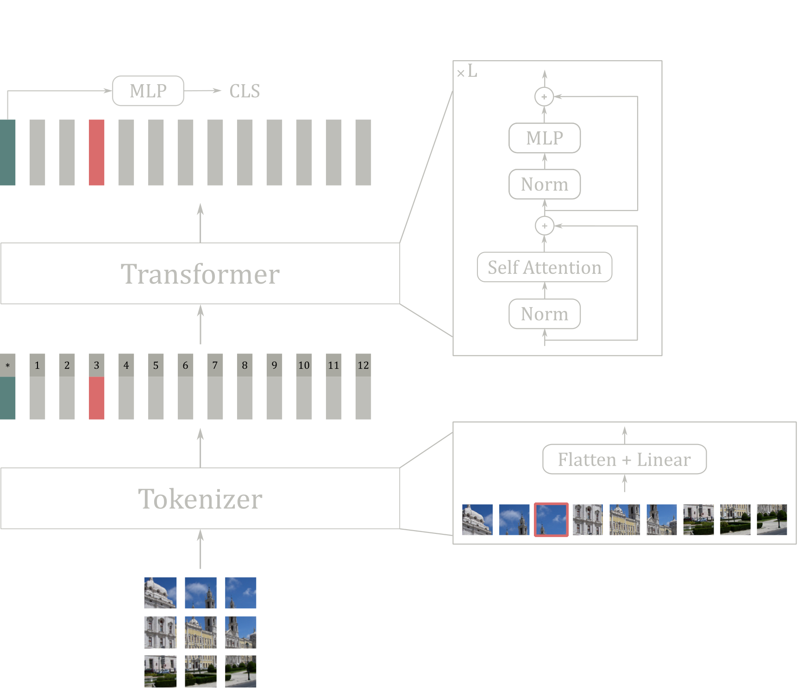
Method

Slide 12
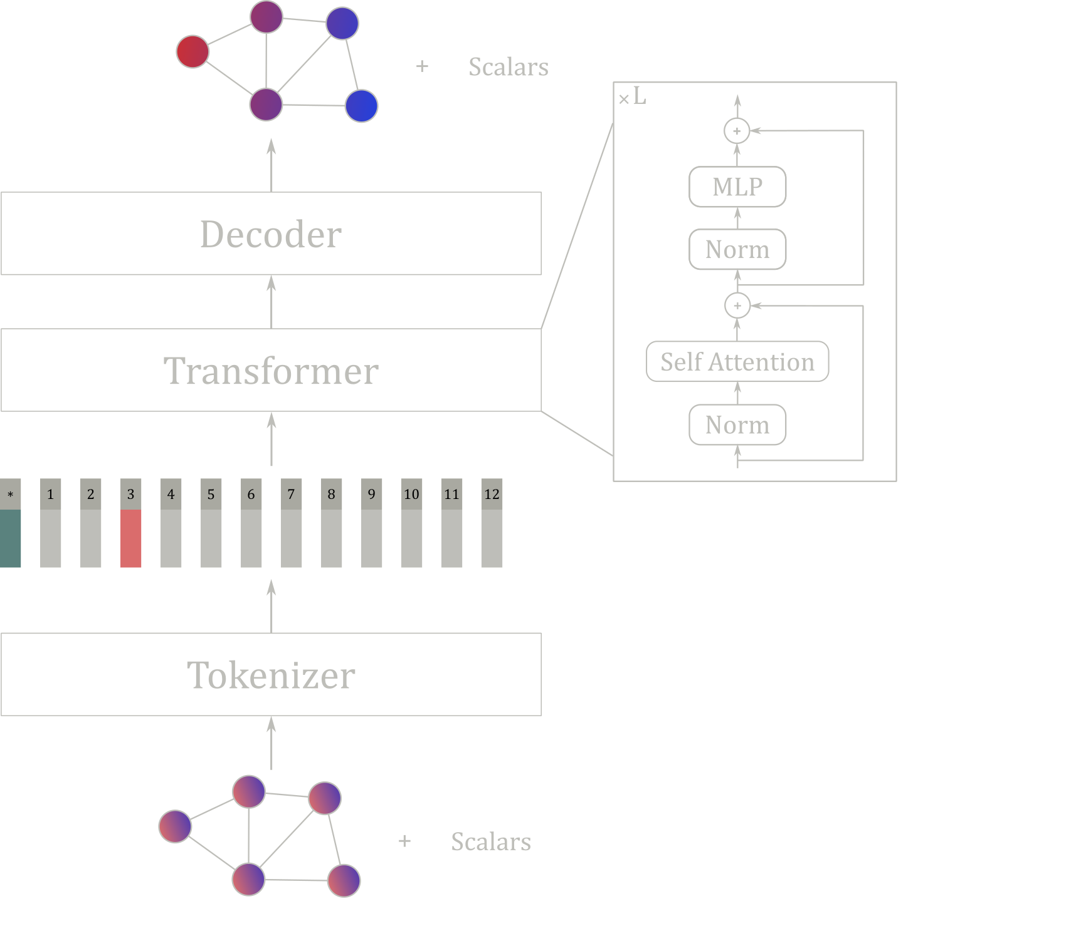
Method

Slide 13
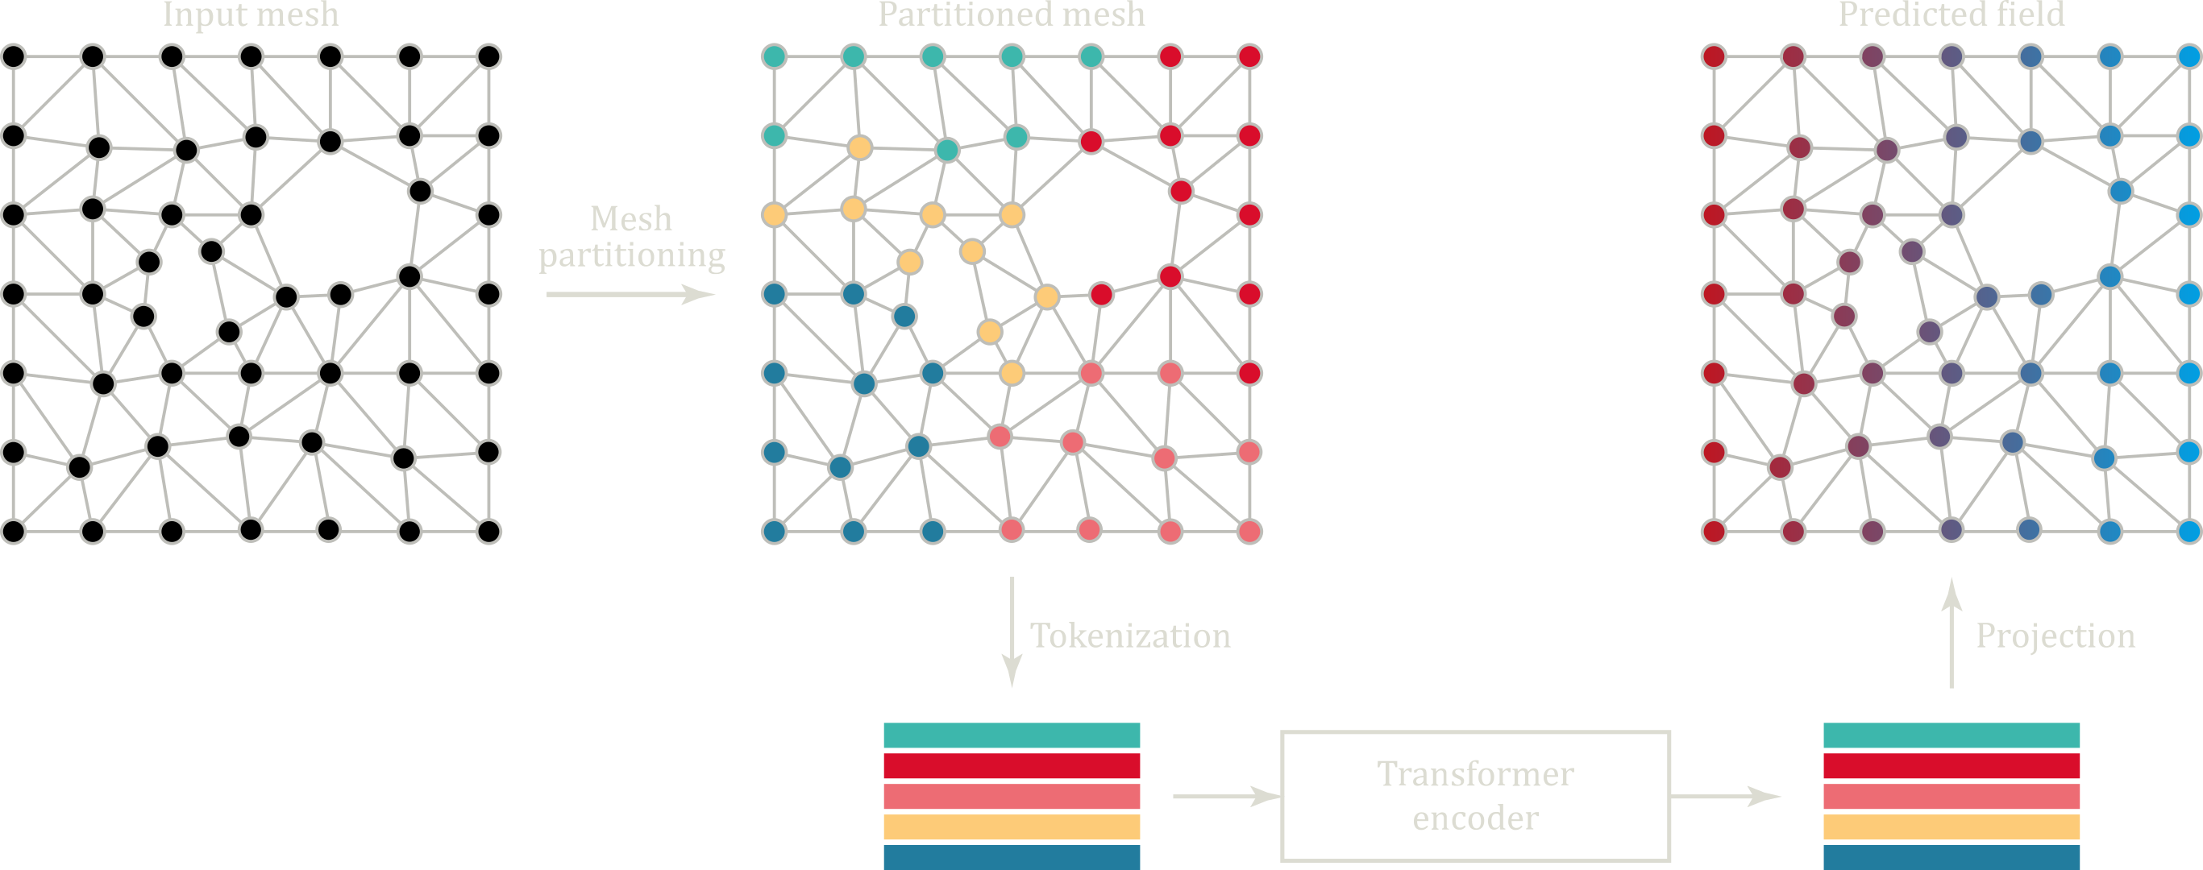
Method

Slide 14
Experiments
Questions
Order of nodes within each patch?
Patch regularity
Patch consistency across samples (relative position of patches)?
Shape of patches?
Positional encoding?

Slide 15
Experiments
Order of points within each patch
Morton ordering

Slide 16
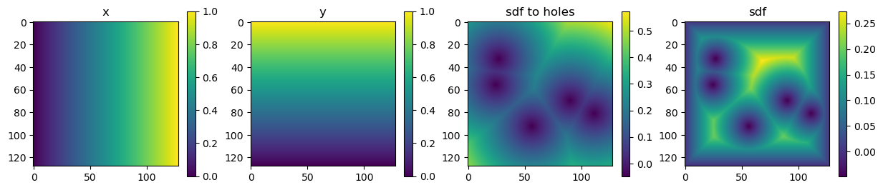

Experiments
Patch regularity? Cross sample consistency / Patch shape?
Mesh → image
Powerful mesh processing with Muscat

Slide 17
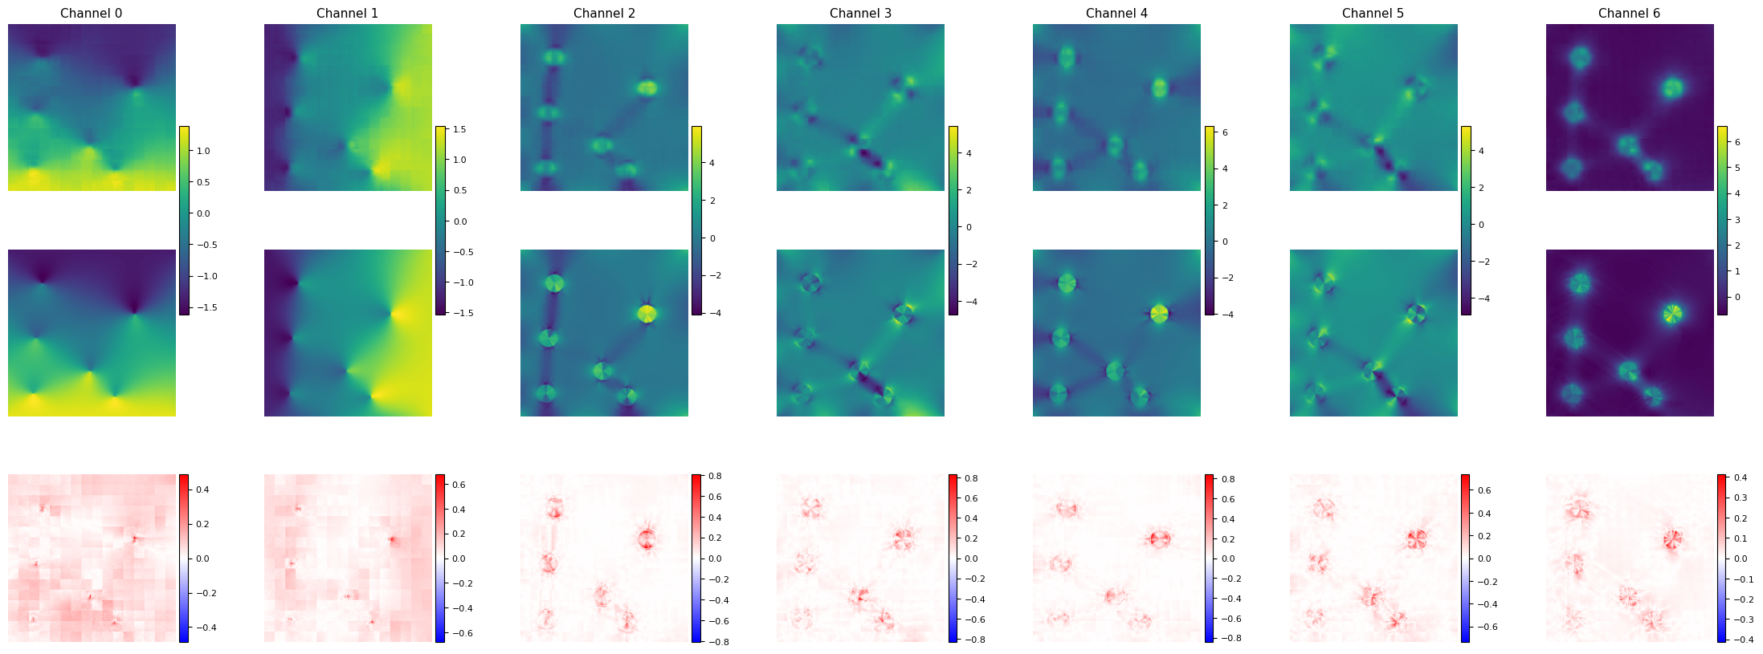
Experiments
Patch regularity? Cross sample consistency / Patch shape ✅
ViT with 2D patch PE

Slide 18
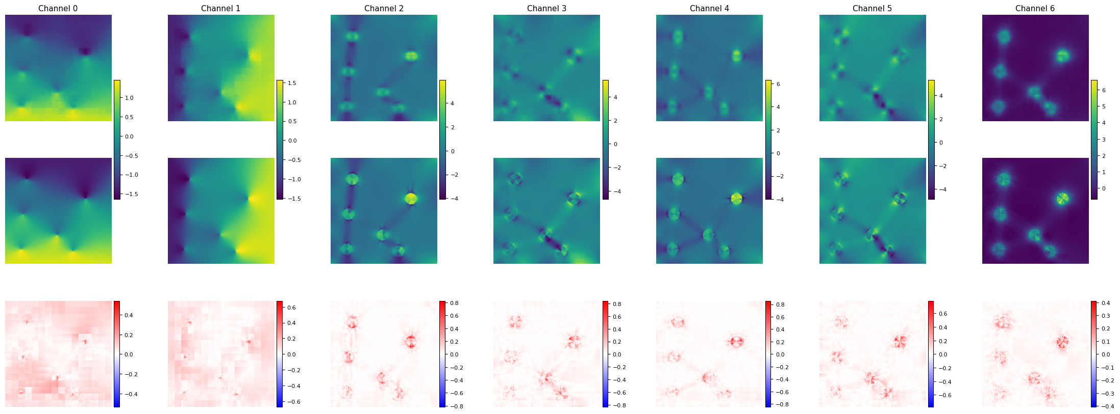
Experiments
Positional encoding? ❌
ViT with 2D patch PE

Slide 19
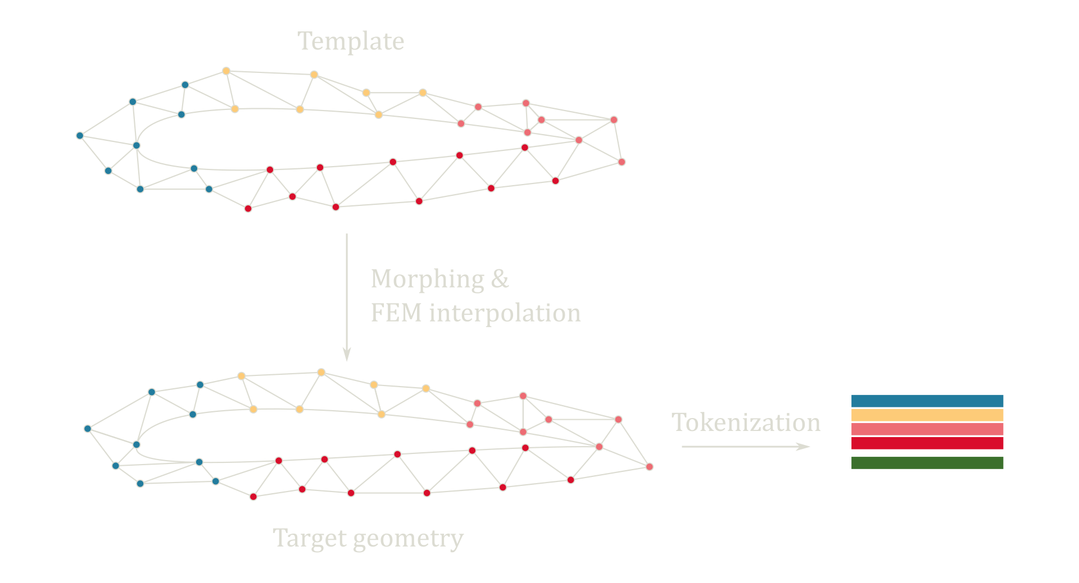
Experiments
Patch consistencity across samples?
MMVT (Mesh Morphing Vision Transformer)

Slide 20
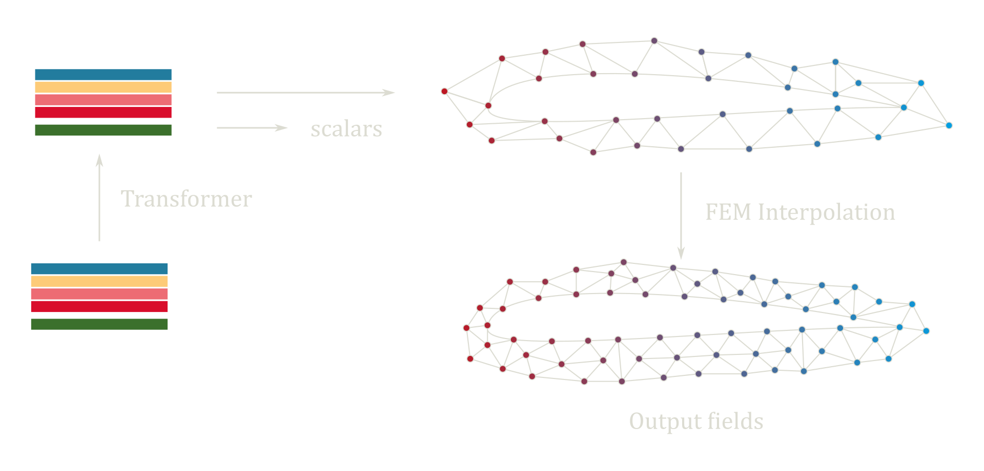
Experiments
Patch consistencity across samples?
MMVT (Mesh Morphing Vision Transformer)

Slide 21



Results
PLAID Benchmark

Slide 22
Thank you for your attention!
POWERED BY TRANSFORMERS

